Slide 1

Graph Data Management and Analysis
Lei Zou
Peking University
zoulei@pku.edu.cn

Slide 2
Outline
Introduction to Graph Data.
Course Content and Schedule
Course Assessment

Slide 3
Part 1
Introduction to Graph Data

Slide 4
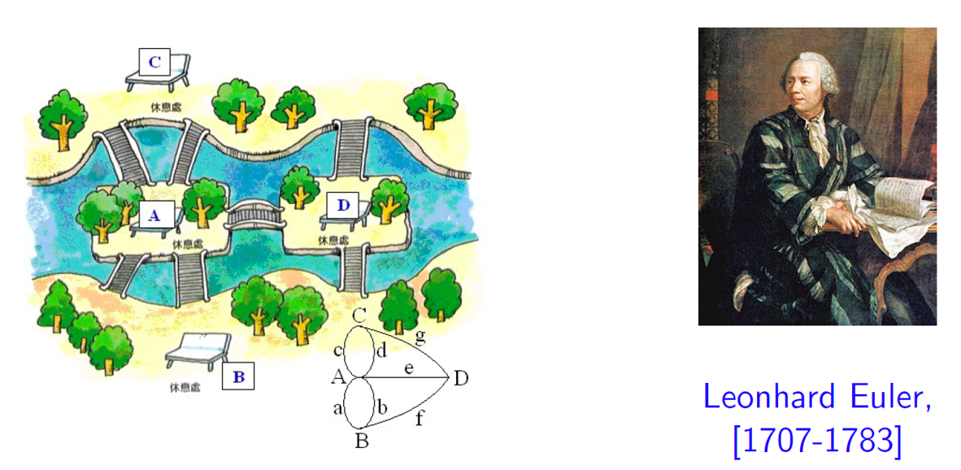
Graph
[Seven Bridges of Knigsberg, 1736] The problem is to devise a walk across each of the seven bridges once and only once to touch every part of the town; or this walk does not exist.

Slide 5
Graph
A graph is a set of nodes and edges that connect them:
Node
Edge

Slide 6
Networks or Graphs
Network often refers to real systems
Web, Social Network, Metabolic network
Language: Network, node, link
Graph is a mathematical representation of a network
Web graph, Social graph, knowledge graph
Language: Graph, vertex, edge

Slide 7
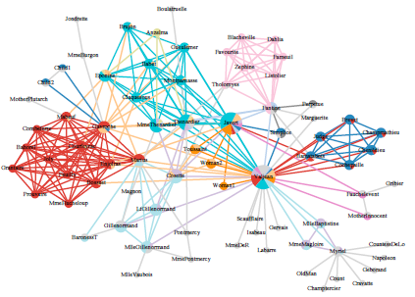
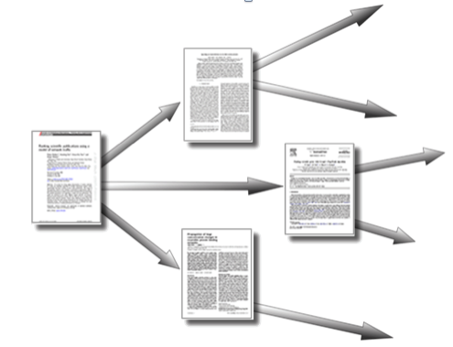
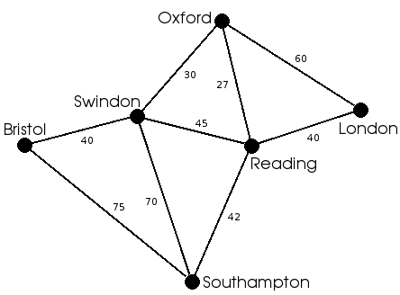
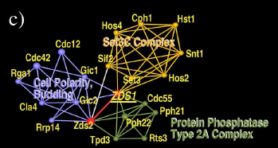
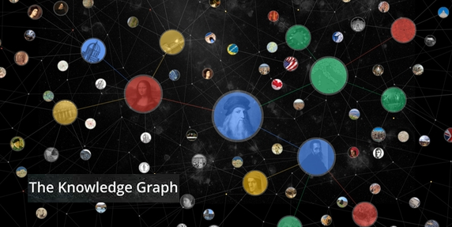
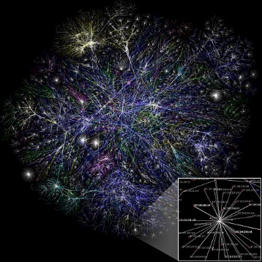
Graph
Graph is everywhere:
Social Network
Citation Network
Road Network
Protein Network
Knowledge Graph
Internet

Slide 8

Graph
webpage link network
Which page is more important ?
PageRank algorithm.

Slide 9
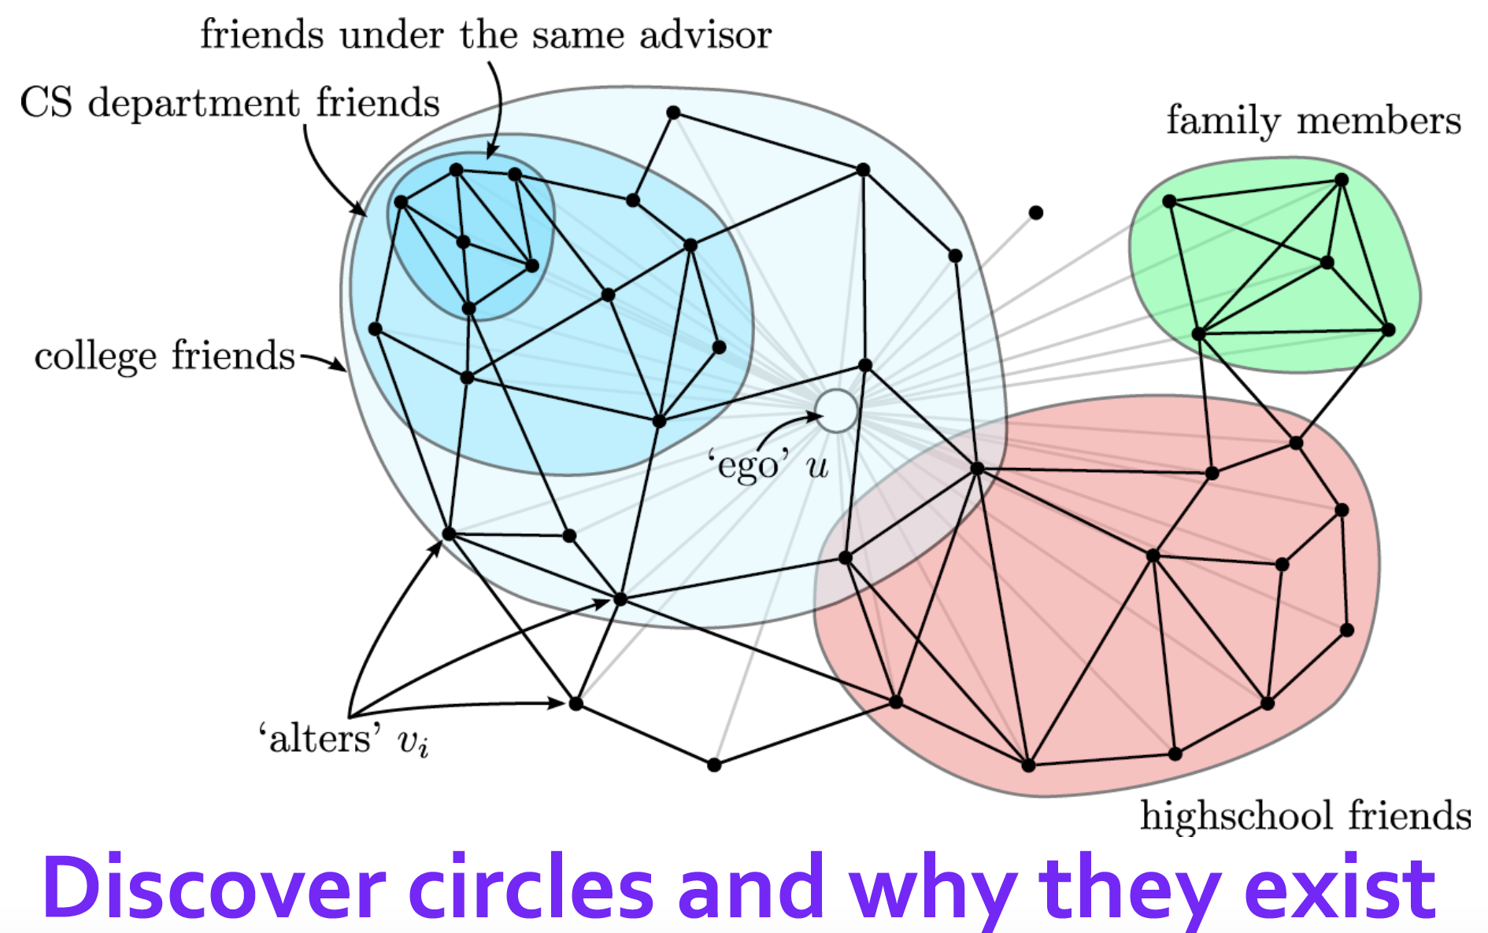
Graph
Community Detection &
Friend Recommendation.

Slide 10
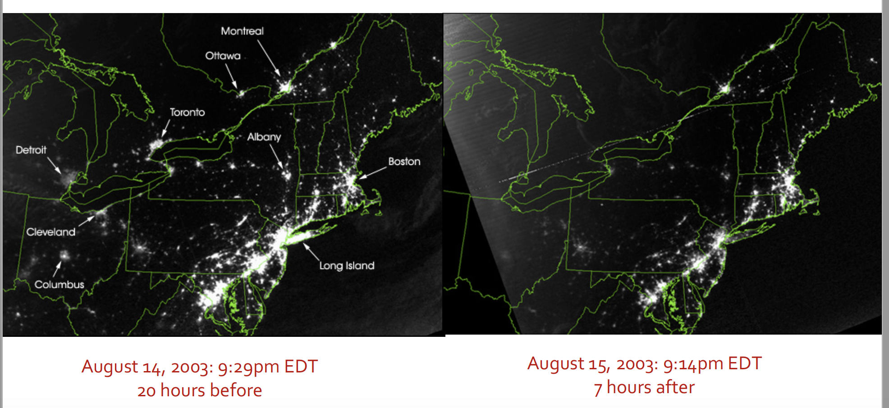
Graph
How to design a robust power grid to avoid cascading failure ?

Slide 11
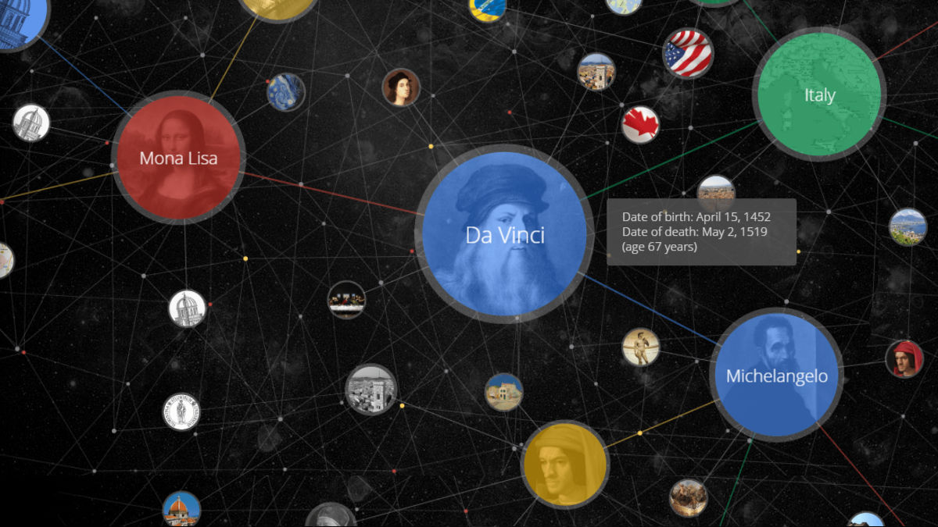
Graph
Knowledge graph is an important tool in the next generation AI.

Slide 12
Graph
Why is graph important ?
Graph is a general data structure to model the relations between entities.
Universal language for describing complex data
Data availability & computational challenges
links to both two hot keywords---“Big Data” and “AI”

Slide 13
Graph---terminology
Undirected graph
Links: undirected
(symmetrical, reciprocal )
directed graph
Links: directed
(arcs)
Examples: network communication
following in Weibo
phone calls
Examples: collaborations
friends-on-Wechat

Slide 14
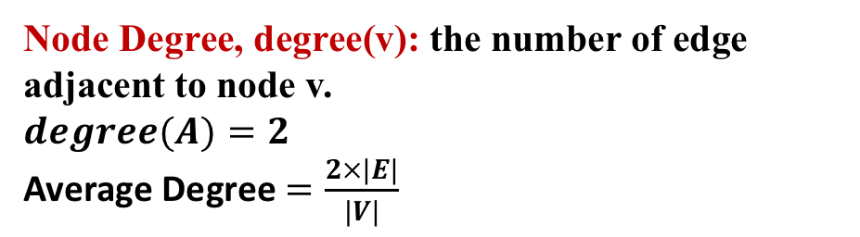
Graph---terminology
Node Degree, degree(v): the number of edge adjacent to node v.
$$degree(A)=2$$
Average Degree $=\frac{2×|E|}{|V|}$
A
In directed graph, we define an in-degree and out-degree. The (total) degree of a node is the sum of in- and out-degrees.
Source: Node with in-degree = 0.
Sink: Node with out-degree = 0.
A

Slide 15
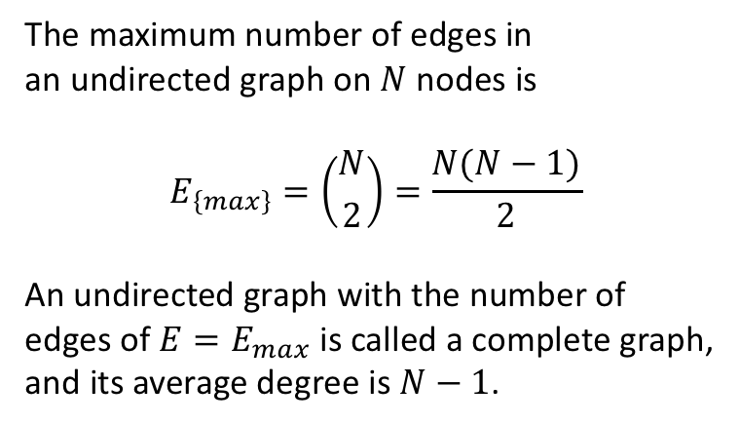
Graph---terminology
Complete Graph (Clique)
The maximum number of edges in
an undirected graph on $N$ nodes is
$$E_{\left\{max\right\}}=\left({N \atop 2}\right)=\frac{N(N−1)}{2}$$
An undirected graph with the number of
edges of $E=E_{max}$ is called a complete graph, and its average degree is $N−1$.

Slide 16
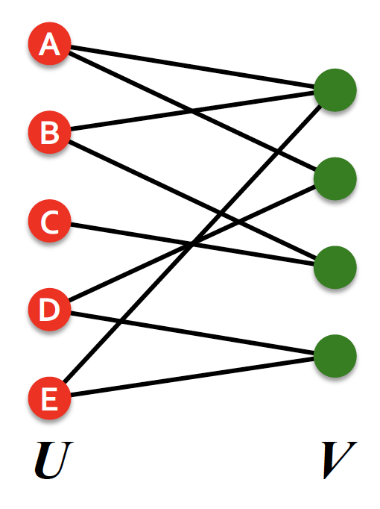
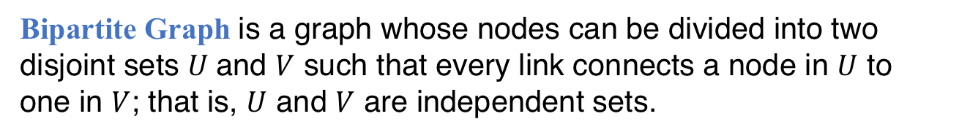
Graph---terminology
Bipartite Graph is a graph whose nodes can be divided into two disjoint sets $U$and $V$ such that every link connects a node in $U$ to one in $V$; that is, $U$ and $V$ are independent sets.
Examples:
Authors-to-Papers ;
Buyers-to-Products ;

Slide 17
Graph---terminology
Bipartite Graph is a graph whose nodes can be divided into two disjoint sets $U$and $V$ such that every link connects a node in $U$ to one in $V$; that is, $U$ and $V$ are independent sets.
Examples:
Authors-to-Papers ;
Buyers-to-Products ;

Slide 18
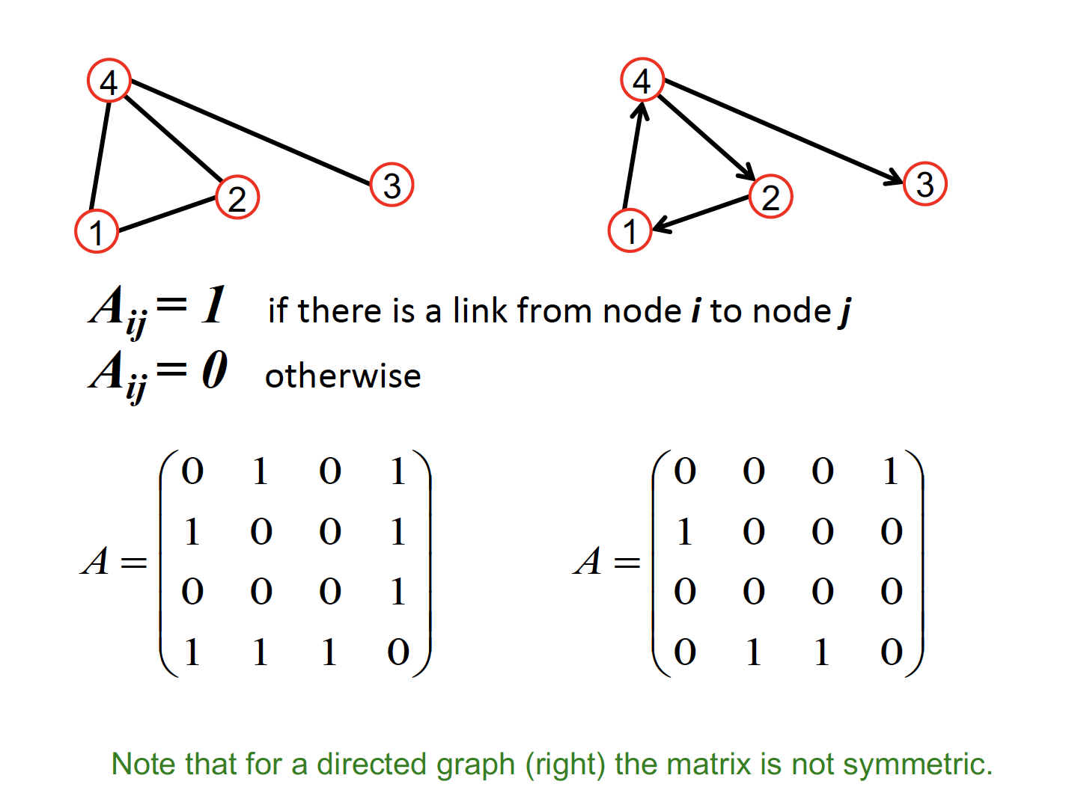
Graph---terminology
Representing Graph—adjacency matrix

Slide 19
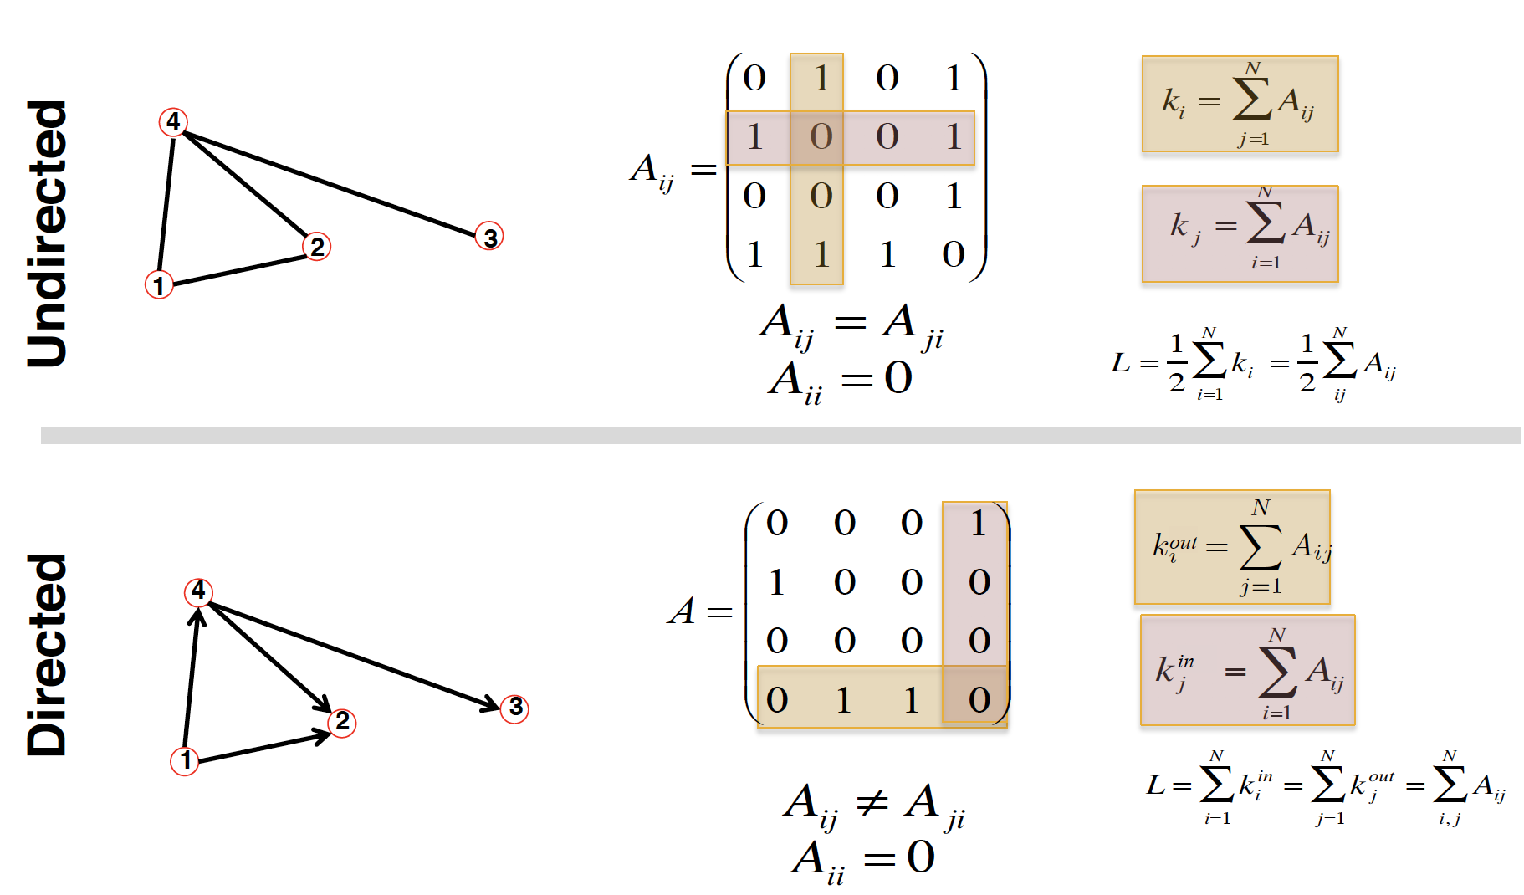
Graph---terminology
Representing Graph—adjacency matrix

Slide 20
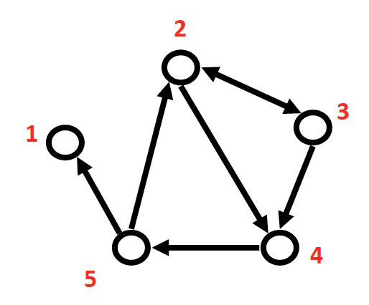
Graph---terminology
Representing Graph—adjacency list
Easier to work with if network is
§ Large
§ Sparse
Allows us to quickly retrieve all neighbors of a given node
e.g.
1:
2: 3, 4
3: 2, 4
4: 5
5: 1, 2

Slide 21
Graph---terminology
Representing Graph—CSR (Compressed Sparse Representation)
1
2
3
4
5
offset
0 | 0 | 2 | 4 | 5
edges
3 | 4 | 2 | 4 | 5 | 1 | 2

Slide 22
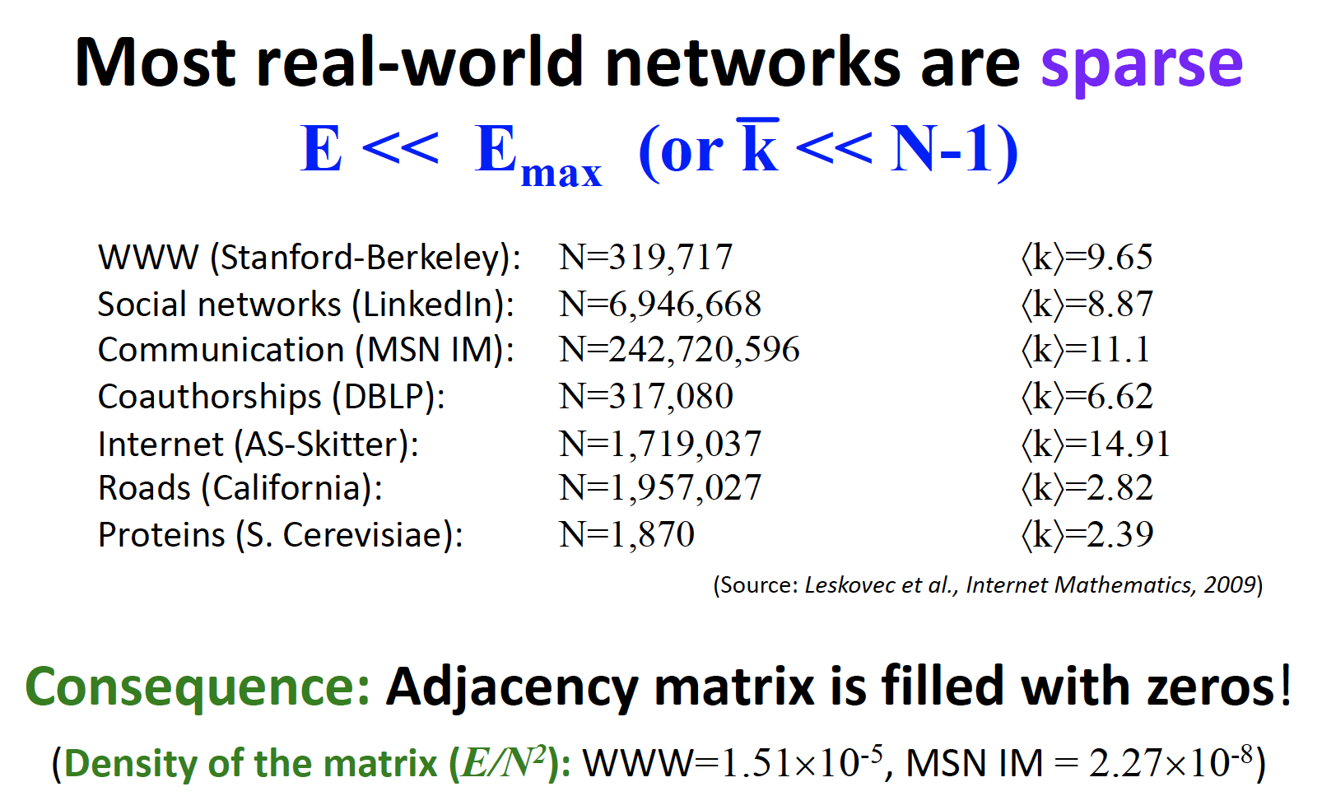
Graph---terminology

Slide 23
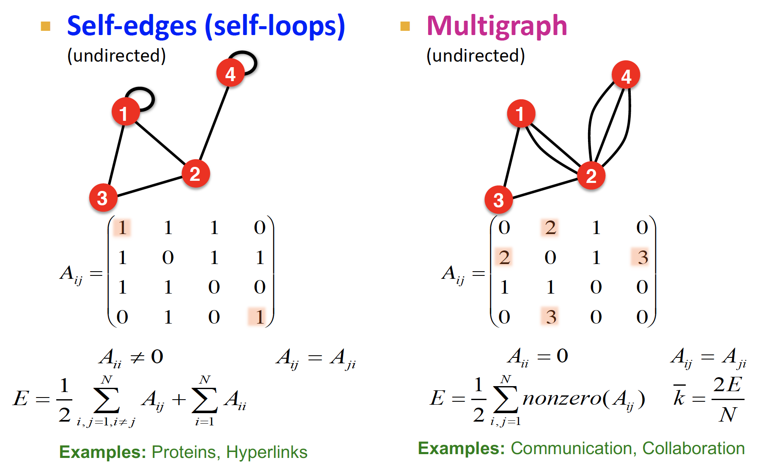
Graph---terminology

Slide 24
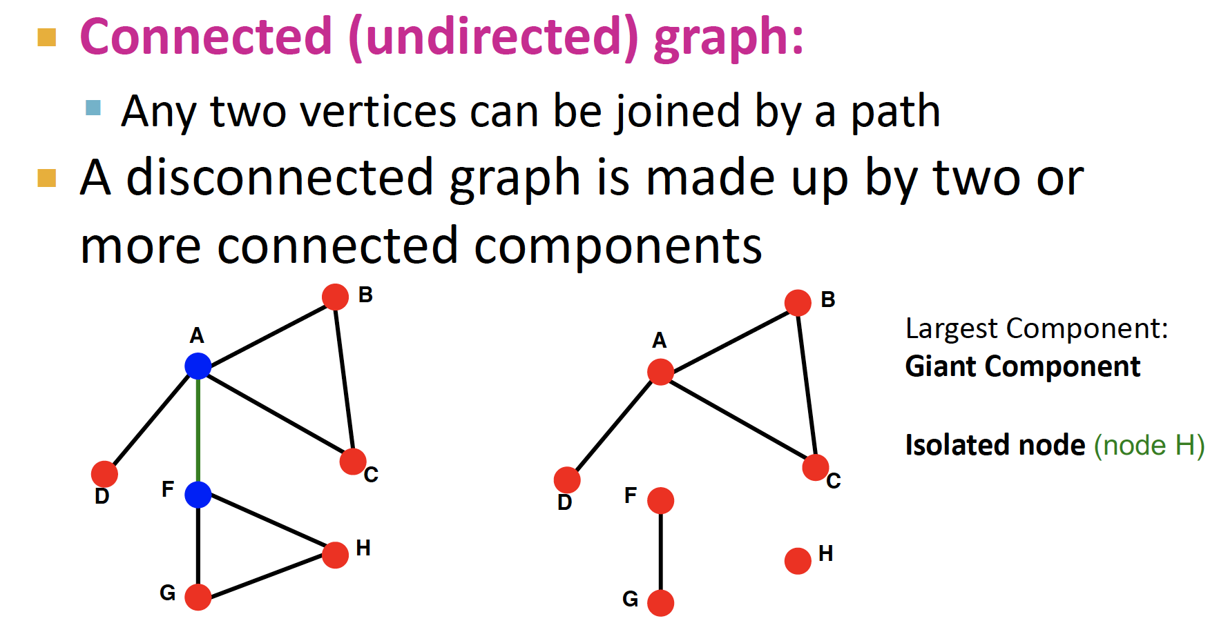
Graph---terminology

Slide 25
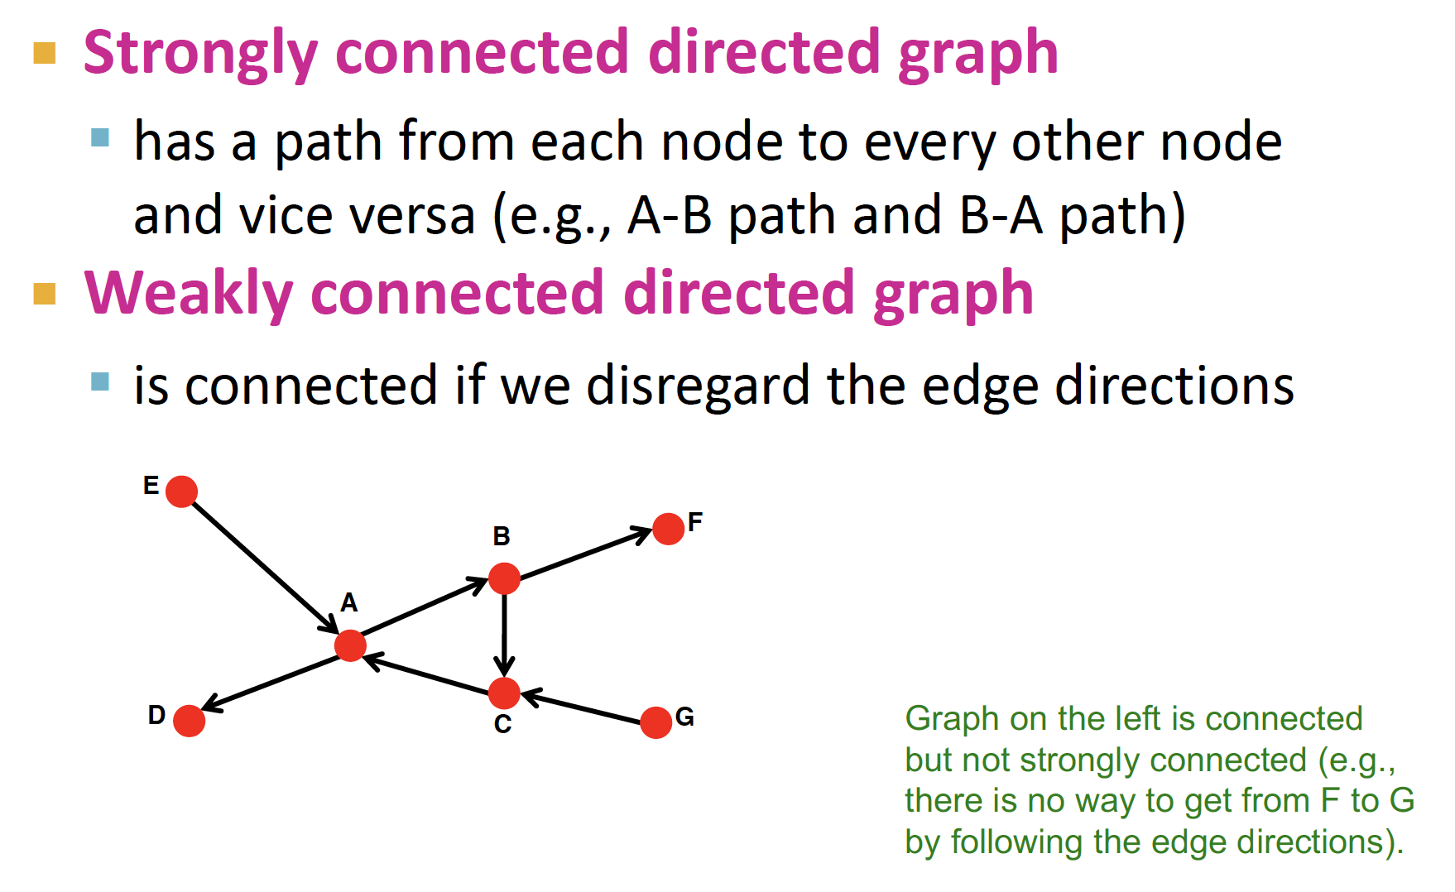
Graph---terminology
Connectivity of directed graph

Slide 26
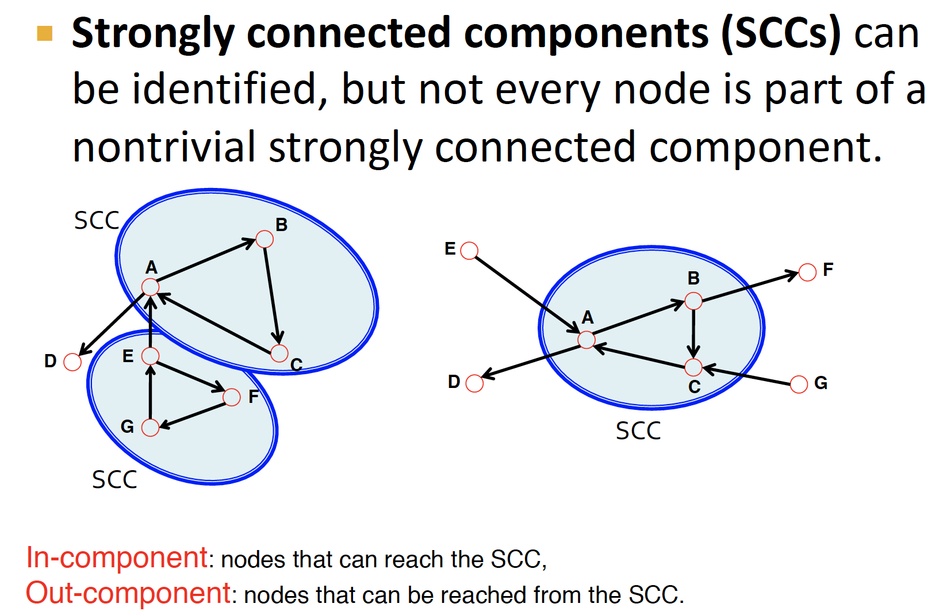
Graph---terminology

Slide 27
Graph---terminology
Graph Representation
How to build a graph:
What are nodes ?
What are edges ?
Choice of the proper network representation of a given domain/problem determines our ability to use network successfully.
In some cases, there is a unique, unambiguous representation
In some cases, the representation is by no means of unique
The way you assign links will determine the nature of the question you study.

Slide 28
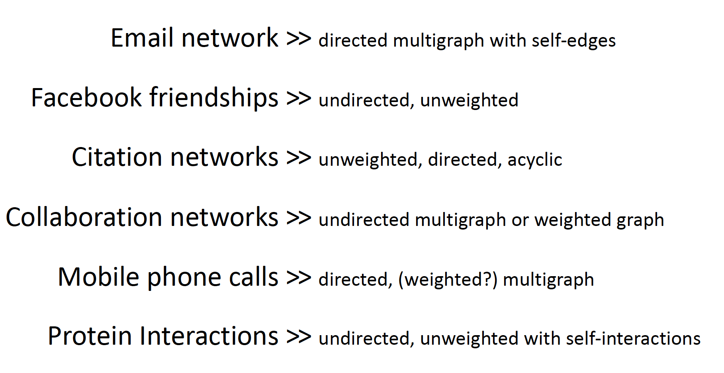
Graph---terminology
Graph Representation

Slide 29
Part 2
Course Content and Schedule

Slide 30
Course Content
Schedule
Graph Algorithms
Knowledge Graphs
Graph Learning
Graph Systems

Slide 31
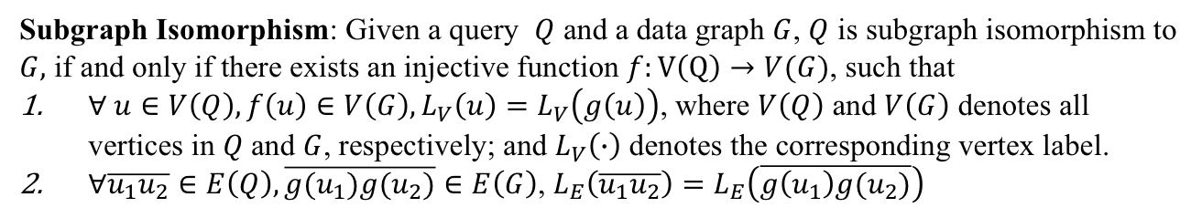
Graph Algorithms
Subgraph Isomorphism: Given a query $Q$ and a data graph $G$, $Q$ is subgraph isomorphism to $G,$ if and only if there exists an injective function $f:V\left(Q\right)→V(G)$, such that
$∀ u∈V\left(Q\right),f\left(u\right)∈V\left(G\right), L_{V}\left(u\right)=L_{V}\left(g\left(u\right)\right)$, where $V\left(Q\right)$ and $V\left(G\right)$ denotes all vertices in $Q$and $G$, respectively; and $L_{V}\left(∙\right)$ denotes the corresponding vertex label.
$∀\overline{u_{1}u_{2}}∈E\left(Q\right),\overline{{g(u}_{1})g(u_{2})}∈E\left(G\right)$, $L_{E}\left(\overline{u_{1}u_{2}}\right)=L_{E}\left(\overline{g\left(u_{1}\right)g(u_{2})}\right)$
1
A
1
A
2
3
B
C
2
3
B
C
4
A

Slide 32
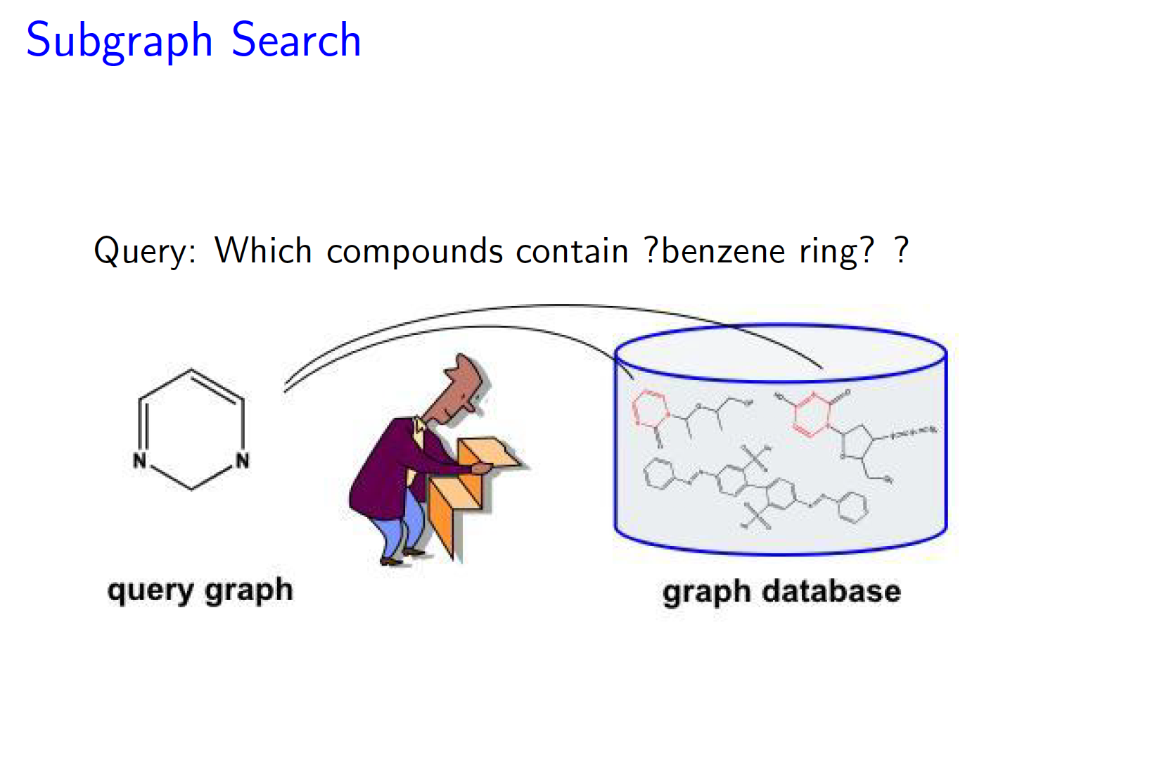
Graph Algorithms

Slide 33
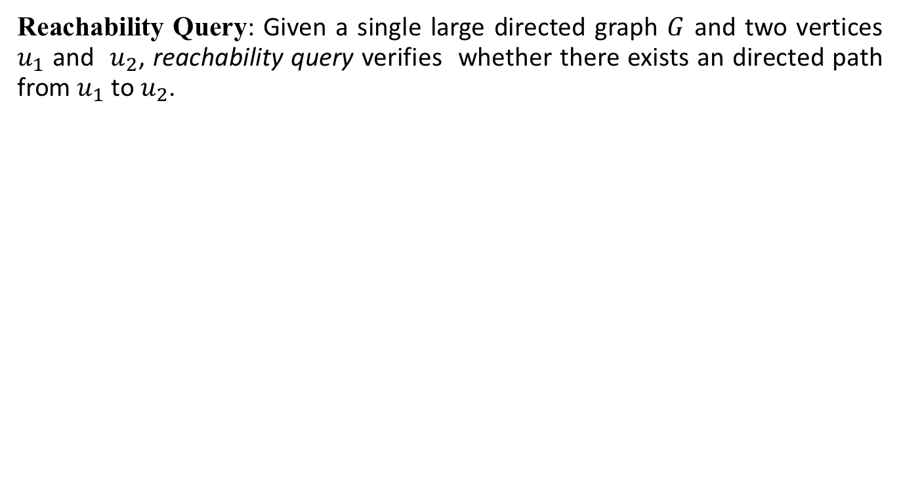
Graph Algorithms
Reachability Query: Given a single large directed graph $G$ and two vertices $u_{1}$ and $u_{2}$, reachability query verifies whether there exists an directed path from $u_{1}$ to $u_{2}$.
?Query(1,11)
Yes
?Query(3,9)
No
15
14
11
13
10
12
6
7
8
9
3
4
5
1
2

Slide 34
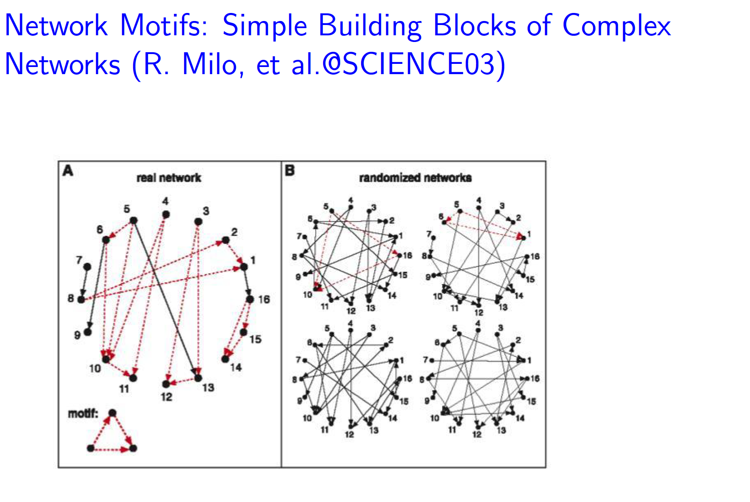
Graph Algorithms
Network Motif

Slide 35
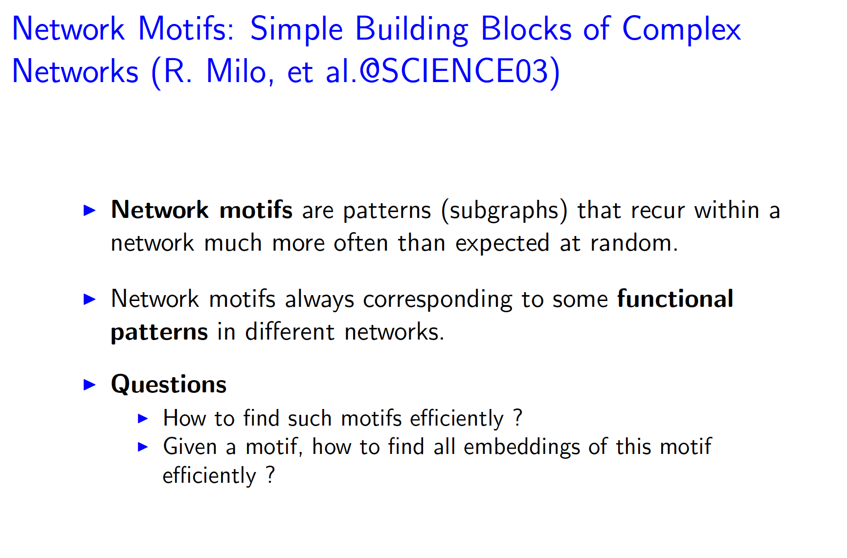
Graph Algorithms
Network Motif

Slide 36
Graph Algorithms
Network Motif

Slide 37
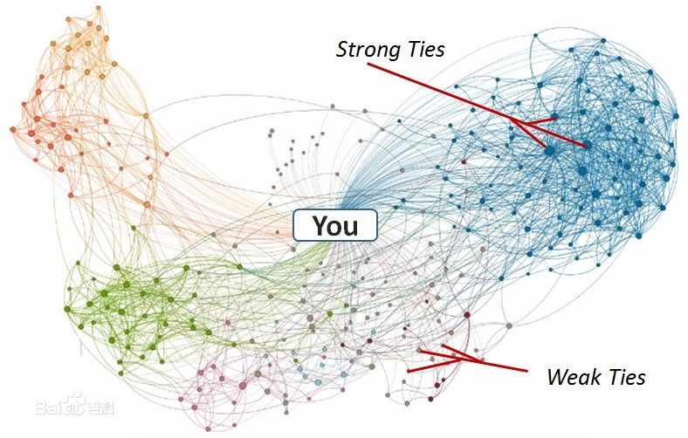
Graph Algorithms
Social Network and Spread of Influence
Social network plays a fundamental role as a medium for the spread of INFLUENCE among its members
Opinions, ideas, information, innovation…
It is important to understand how the dynamics of adoption are likely to unfold within the underlying social network.
---“word-of-mouth” and “viral marketing”

Slide 38
Graph Algorithms
Influence Maximization
Given
a limited budget B for initial advertising (e.g. give away free samples of product)
estimates for influence between individuals
Goal
trigger a large cascade of influence (e.g. further adoptions of a product)
Question
Which set of individuals should B target at?
Application besides product marketing
spread an innovation
detect stories in blogs

Slide 39
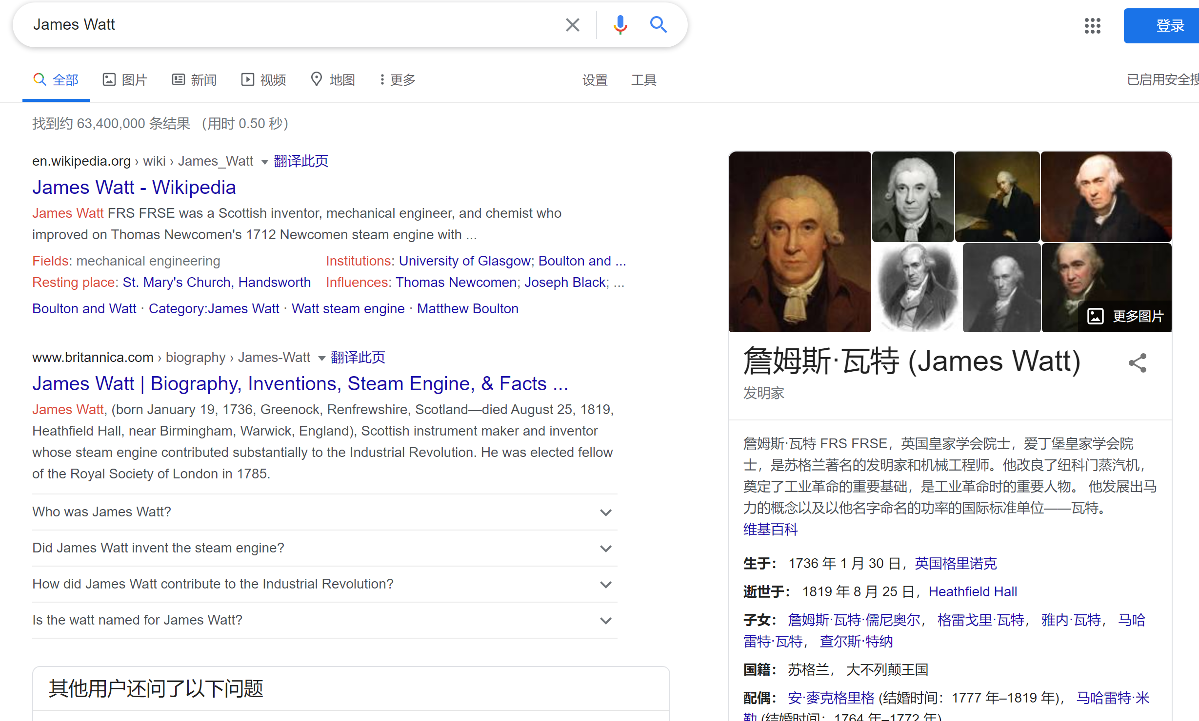
Knowledge Graphs

Slide 40
Knowledge Graphs
Essentially, KG is graph-based semantic network, representing the relation between entities.

Slide 41
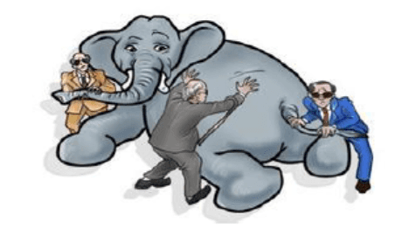
Knowledge Graphs
Database
RDF Database
Data Integration
Nature Language
Processing
Information Extraction
Semantic Parsing
Machine Learning
KG representation
（Node/Graph Embedding）
Knowledge Engineering
Knowledge Base Construction
Rule-based Reasoning

Slide 42



Knowledge Graphs
KB construction
[Mendes et al. 12; Suchanek et al. 07; Bollacker ]
Leipzig University
University of Mannheim
OpenLink Software
Max-Planck-Institute
Metaweb Company,
acquired by Google in 2010
1.1 Billion Triples
180 Million Triples
2.5 Billion Triples

Slide 43
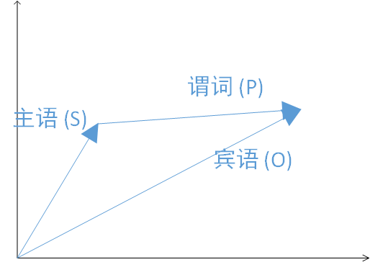
Knowledge Graphs
Knowledge Representation: TransE [Bordes et al., NIPS 13]
For each triple (Subject,Predicate,Object), “Predicate” as a translation from Subject to Object
Each Subject/Predicate/Object in KG maps to a multidimension vectors
Objective: S+P=O
S | P | O
China | Capital | Beijing
Canada | Capital | Ottawa
…… | …… | ……
Beijing − China
≈
=Capital
Ottawa − Canada

Slide 44
Knowledge Graphs
Semantic Parsing [Zettlemoyer et al., UAI 05]
Transforming natural language (NL) sentences into computer executable complete meaning representations (MRs) for domain-specic applications.
E.g., “Which states borders New Mexico ?”
Lambda-calculus [Alonzo Church, 1940 ]
“Simply typed Lambda-calculus can express varies database query languages such as relational algebra, fixpoint logic and the complex object algebra." [Hillebrand et al., 1996]

Slide 45
Knowledge Graphs
SELECT ?name
WHERE {
?m <bornIn> ? c i t y .
?m <hasName> ?name .
?m <bornOnDate> ?bd .
? c i t y <foundingYear> ` `1718 ' ' .
FILTER( regex (str (?bd ), “1 9 7 6 ' ' ) )
}
SPARQL
RDF Database Systems
Subject | Predicate | Objects
Abraham_Lincoln | hasName | “Abraham Lincoln"
Abraham_Lincoln | BornOnDate | “1809-02-12"
Abraham_Lincoln | DiedOnDate | “1865-04-15"”
Abraham_Lincoln | DiedIn | Washington_DC
Abraham_Lincoln | bornIn | Hodgenville KY
Reese_Witherspoon | bornOnDate | "1976-03-22"
Reese_Witherspoon | bornIn | New_Orleans_LA
New_Orleans_LA | foundingYear | “1718”
New Orleans LA | locatedIn | United_States
United_States | hasName | “United States”
United_States | hasCapital | Washington_DC
United_States | foundingYear | “1776”
SQL
SELECT T2 . o b j e c t
FROM T as T1 , T as T2 , T as T3 ,
T as T4
WHERE T1.property=" bornIn "
AND T2.property= "hasName"
AND T3.property= "bornOnDate "
AND T1.subject=T2.subject
AND T2.subject=T3.subject
AND T1.object=T4.subject
AND T4.propety=“foundingYear “
AND T4.object=" 1718 "
AND T3.object LIKE '%1976%'
Too many self-joins

Slide 46
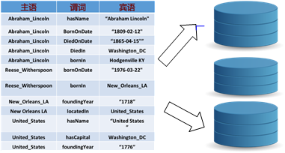
Knowledge Graphs
RDF Database Systems
Property Table Jena [Wilkinson et al., 2003] ,FlexTable [Wang et al., 2010] , DB2-RDF [Bornea et al., 2013]
Vertically partitioned tables SW-store [Abadi et al., 2009]
Exhaustive indexing RDF-3X [Neumann and Weikum, 2008], Hexastore [Weiss et al., 2008]
Basic Ideas: dividing the large single triple-table into several carefully-designed tables.
M. T. Özsu. "A Survey of RDF Data Management Systems", Front. Comp. Sci., 2016.
Lei Zou, M. T. Özsu. “Graph-based RDF Data Management”, Data Science and Engineering, 2(1): 56-70 (2017)

Slide 47
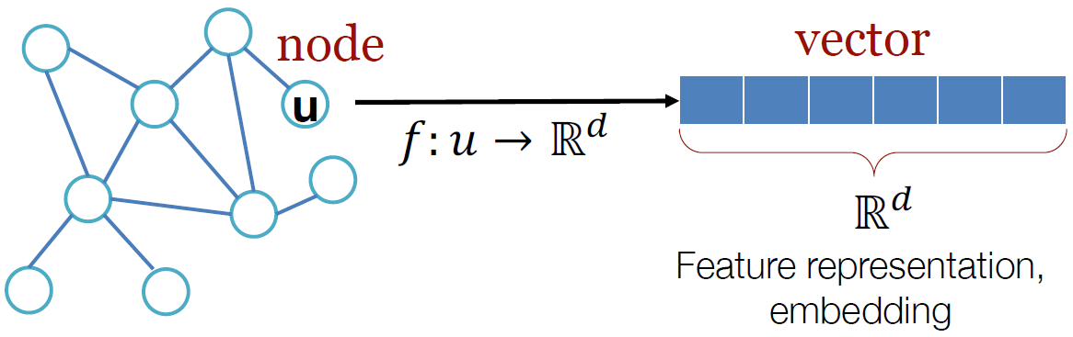
Graph Learning
Graph Embedding, a.k.a. Graph Representation Learning, is a kind of feature learning for networks.

Slide 48
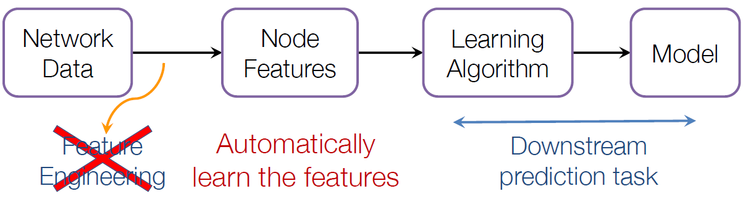
Why Graph Embedding ?
Graph Learning
Machine learning lifecycle (on graphs)
Feature:
Node degree (of neighbors), PageRank/PPR score (of neighbors), motifs…
Attributes on nodes/edges, e.g., texts, tags,…

Slide 49
Why Graph Embedding ?
Graph Learning
Machine learning lifecycle (on graphs)
Feature:
Node degree (of neighbors), PageRank/PPR score (of neighbors), motifs…
Attributes on nodes/edges, e.g., texts, tags,…

Slide 50
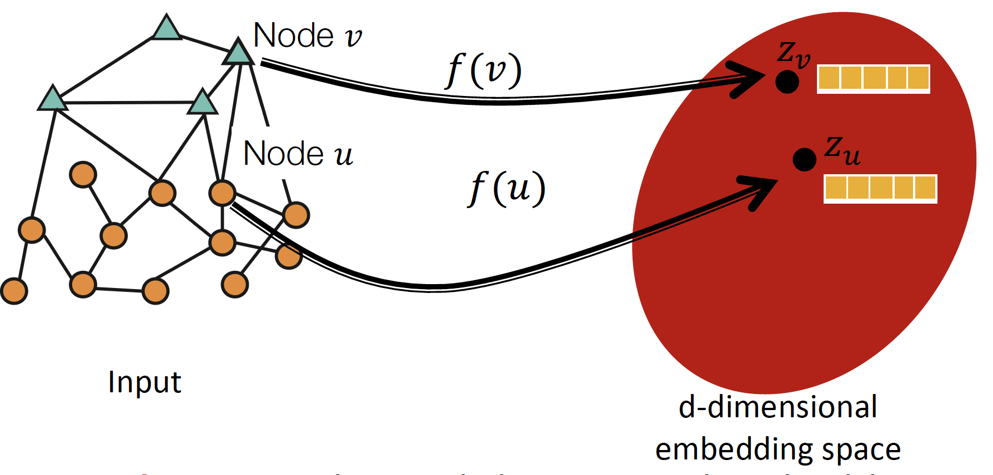
Graph Learning
Goal: Map nodes to d-dimensional embeddings such that nodes with similar network neighbourhoods are embedded close together

Slide 51
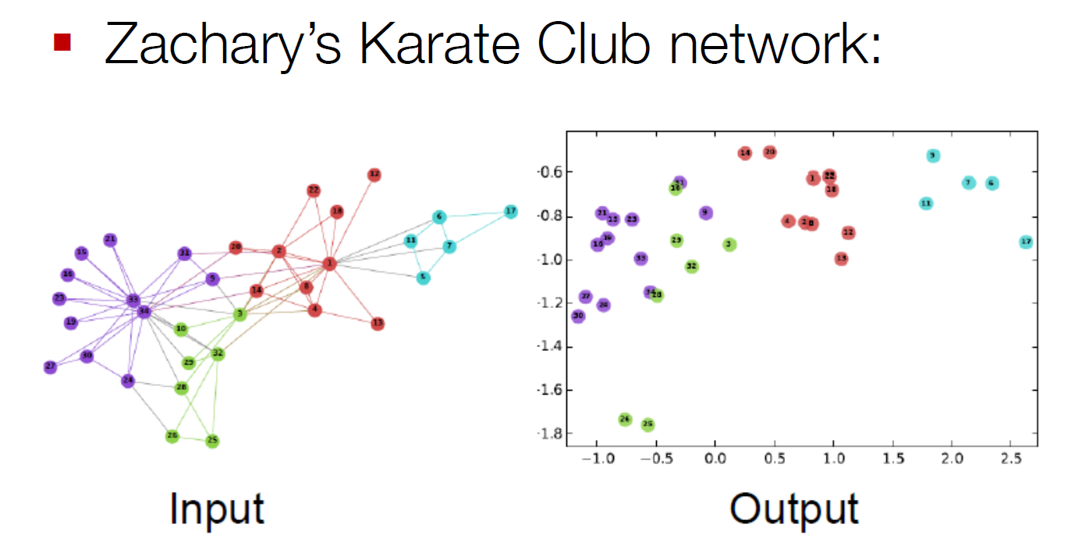
An Example …
Graph Learning
[Image by DeepWalk]

Slide 52
Graph Database: 1. A graph database (GDB) is a database that uses graph structures for semantic queries with nodes, edges, and properties to represent and store data. 2. Working with graph query language, such as SPARQL, Cypher, Gremlin 3. Two categories of graph databases: RDF and property graphs.
Graph Systems

Slide 53
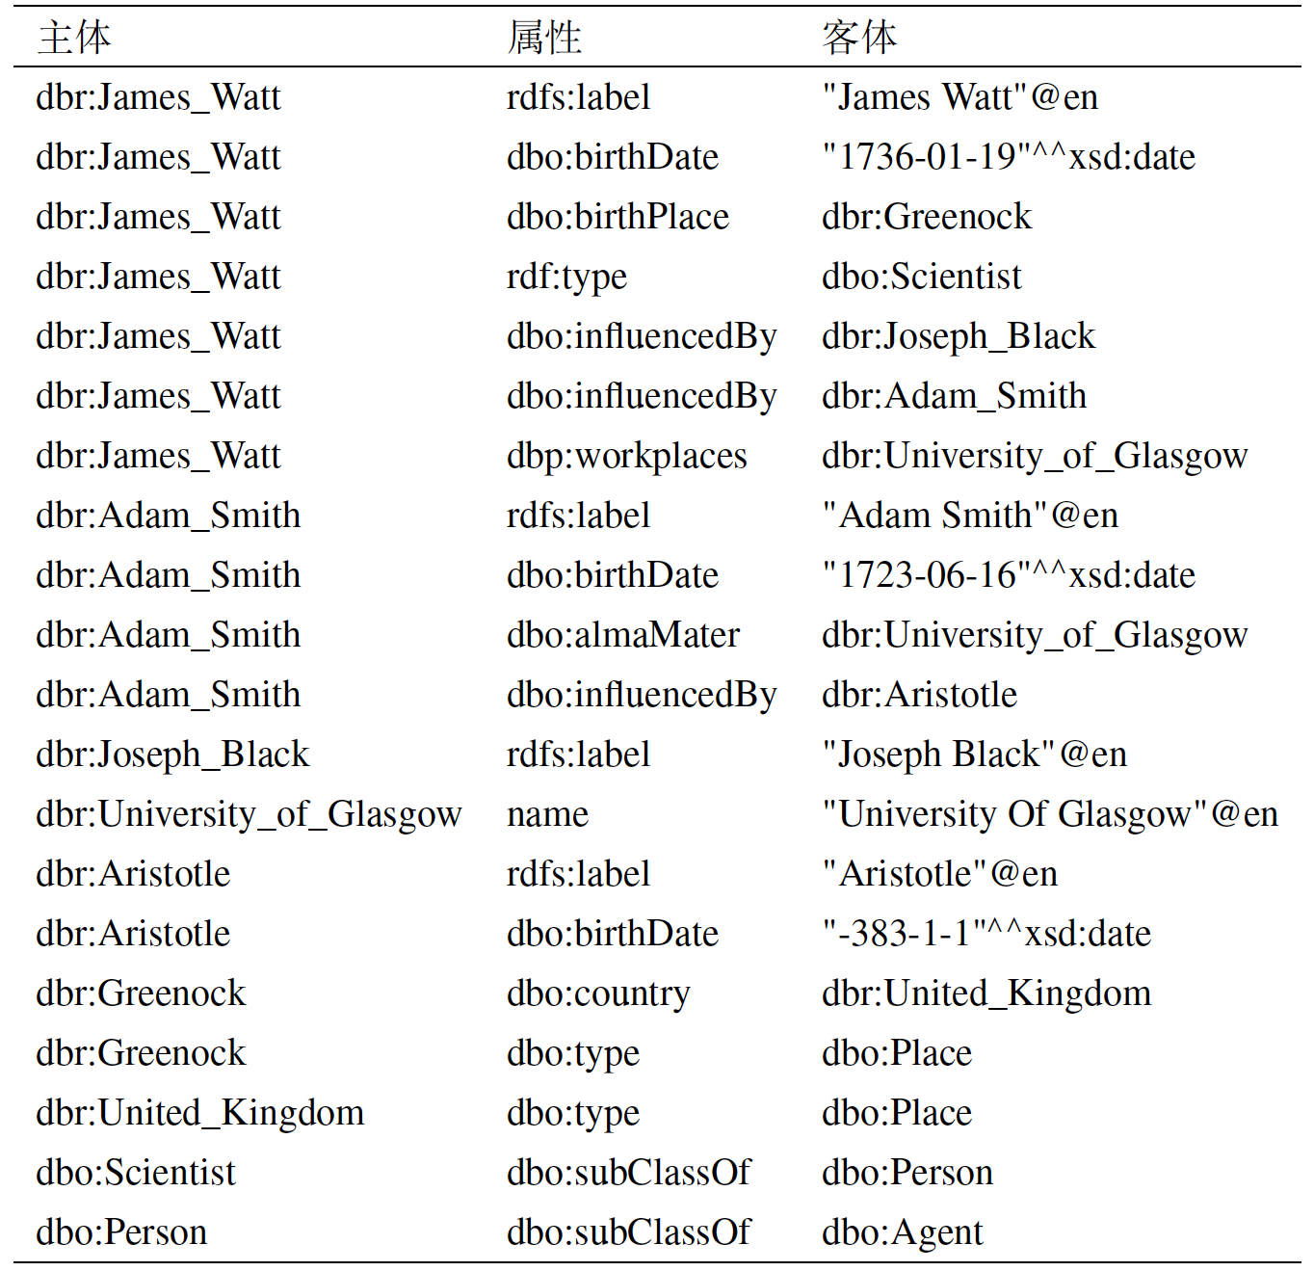
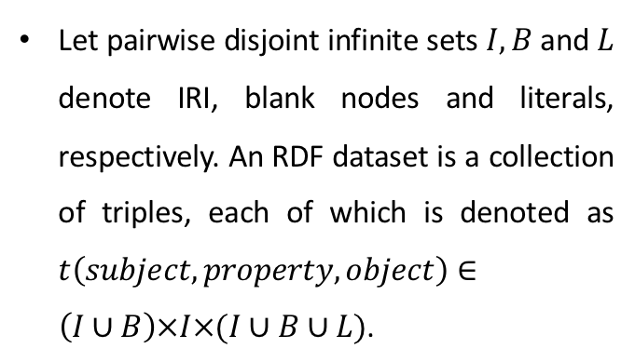
RDF Graphs
RDF Datasets
Let pairwise disjoint infinite sets $I, B$and $L$ denote IRI, blank nodes and literals, respectively. An RDF dataset is a collection of triples, each of which is denoted as $t\left(subject,property, object\right)∈\left(I∪B\right)×I×(I∪B∪L)$.

Slide 54
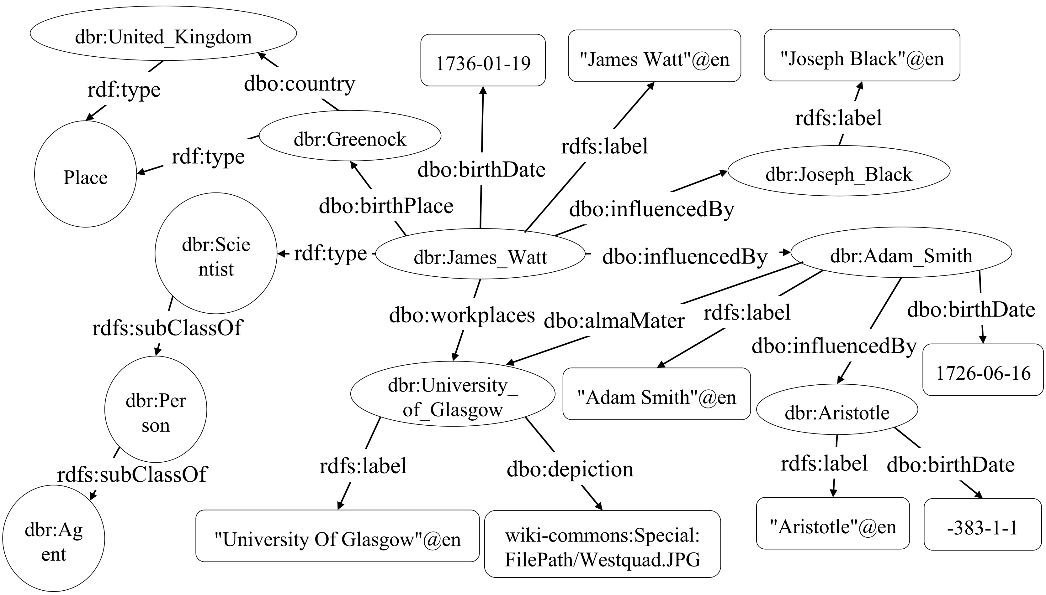
RDF Graphs
RDF Graphs
Each triple corresponds to an edge, where subject and object correspond to two endpoints.

Slide 55
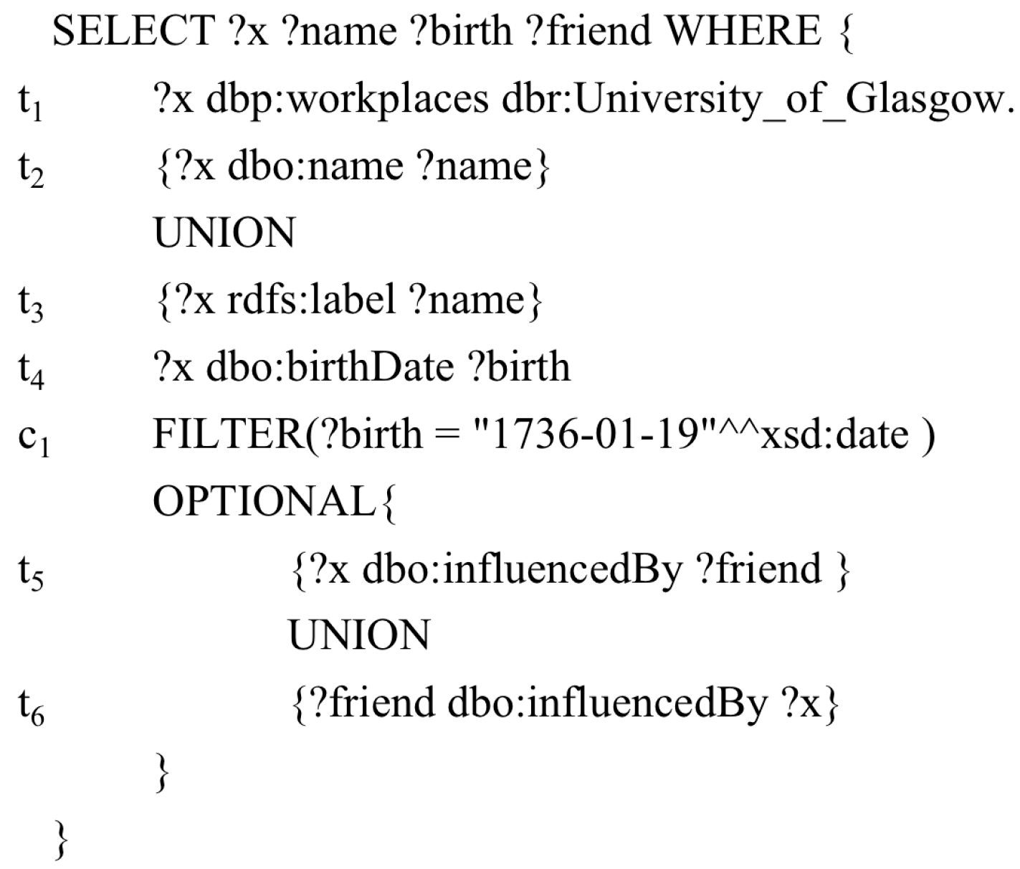
RDF Graphs
SPARQL Queries

Slide 56
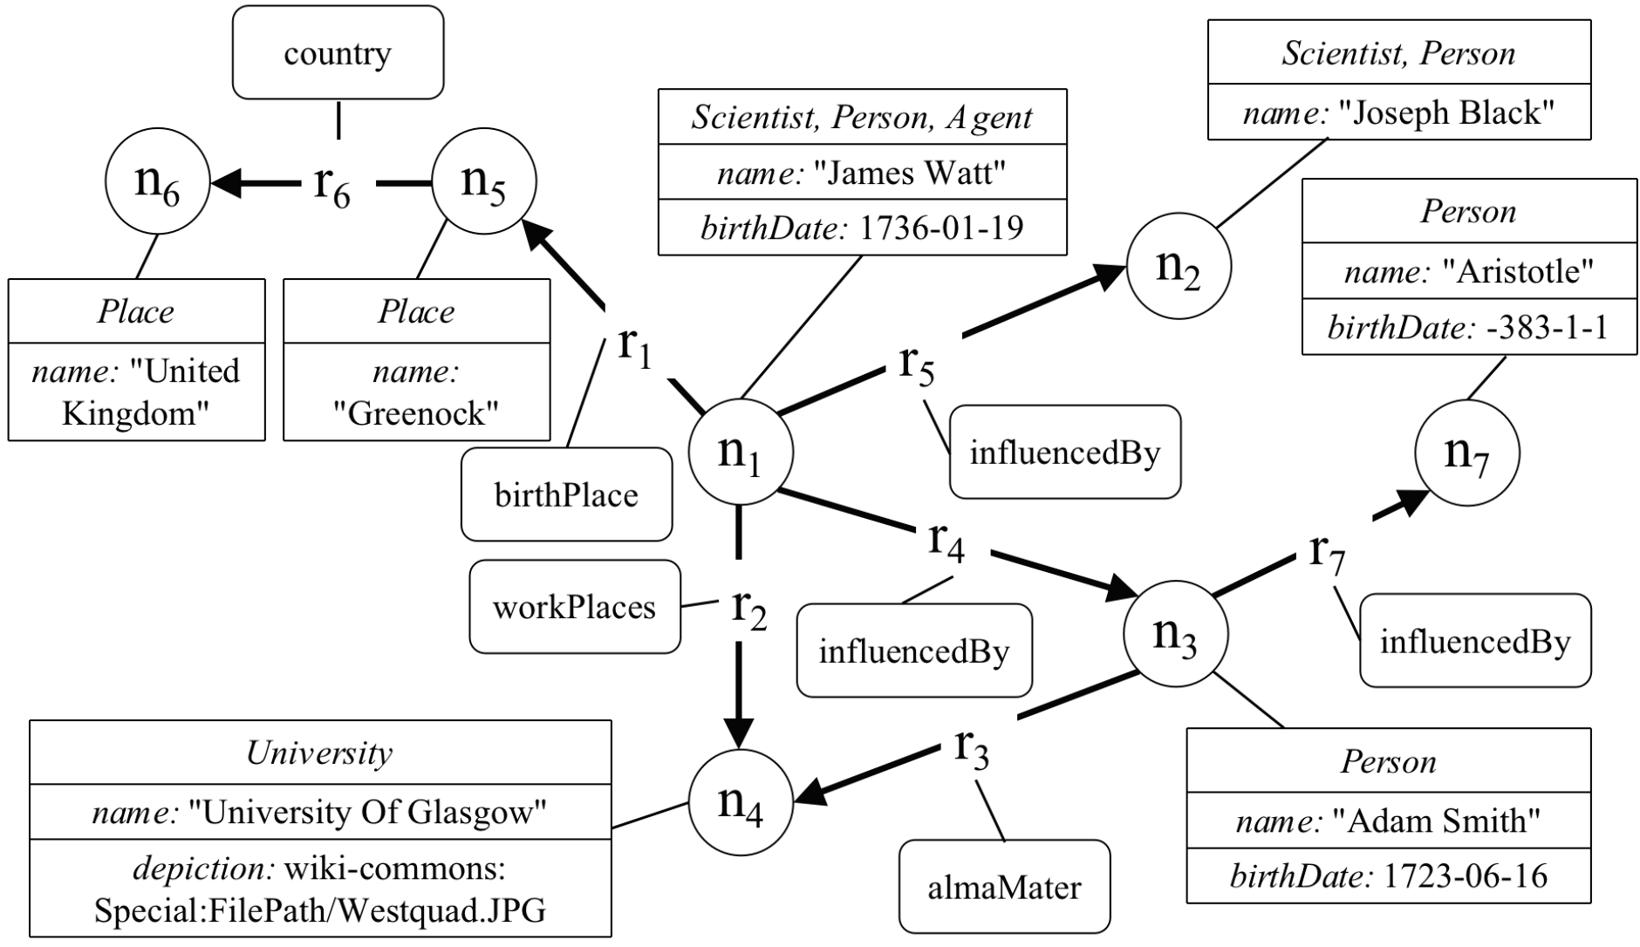
Property Graph
Property Graph
Both vertices and edges can have an arbitrary number of key/value-pairs called properties. Vertices denote discrete objects such as a person, a place, or an event. Edges denote relationships between vertices.

Slide 57
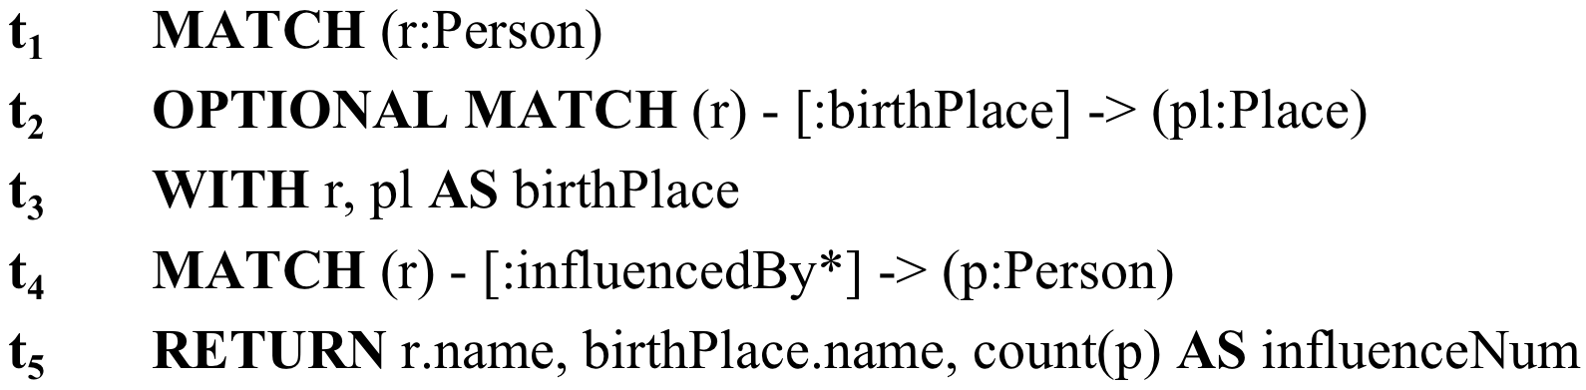
Property Graph
Cypher Queries

Slide 58
Graph Computing Systems
Pregel-like systems are BSP (Bulk Synchronous Parallel ), vertex-centric programs.
“Think like a vertex”
?

Slide 59
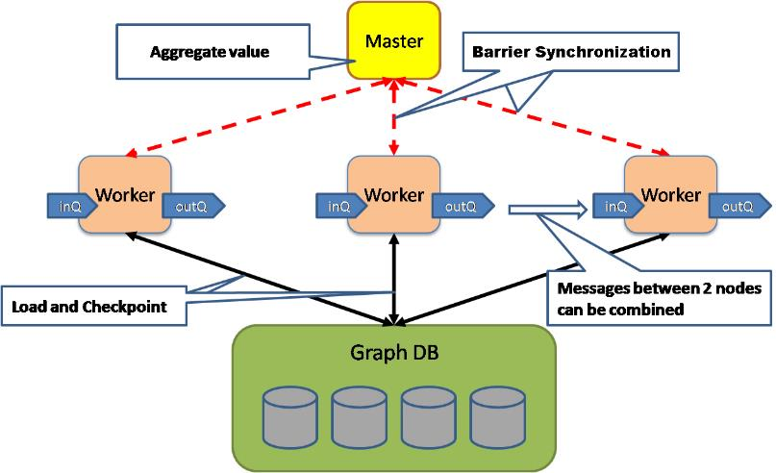

Graph Computing Systems
Master-Slave architecture

Slide 60
Graph Computing Systems
Superstep 0: PR value of each vertex 1/NumVertices()
Class PageRankVertex {
public:
virtual void Compute(MessageIterator* msgs) {
if (superstep () >= 1) {
double sum = 0;
for ( ; !msgs -> Done(); msgs->Next() )
sum += msgs -> Value();
*MutableValue () = 0.15/ NumVertices() + 0.85 * sum;
}
if(superstep() < 30) {
const int64 n = GetOutEdgeIterator().size();
SendMessageToAllNeighbors(GetValue() / n);
}
else {
VoteToHalt();
}
}

Slide 61
Graph Algorithms Implemented with PREGEL (and PREGEL-Like-Systems)
Graph Computing Systems
Page Rank
Triangle Counting
Connected Components
Shortest Distance
Random Walk
Graph Coarsening
Graph Coloring
Minimum Spanning Forest
Community Detection
Collaborative Filtering
Belief Propagation
Named Entity Recognition
Not an Exclusive List

Slide 62
Course Content
Schedule
Graph Algorithms --- 18 hours
Knowledge Graphs --- 15 hours
Graph Learning ---- 6 hours
Graph Systems --- 6 hours
Course seminar-– 6 hours

Slide 63
Part 3
Course Assessment

Slide 64
Course Assessment
Home assignment --- 30%
Course Project --- 30%
Seminar Presentation ---- 30%

